Slide 1
Smart Irrigator
Presented by=>
Mohammad Rashid & Raghavendra Tiwari
(ABES EC Ghaziabad )

Slide 2
Smart Water Manegment
system for agriculture

Slide 3
Introduction to Water Management
To optimize water usage in agriculture
To save over use of water in agriculture
A great transformation to the new agriculture process

Slide 4
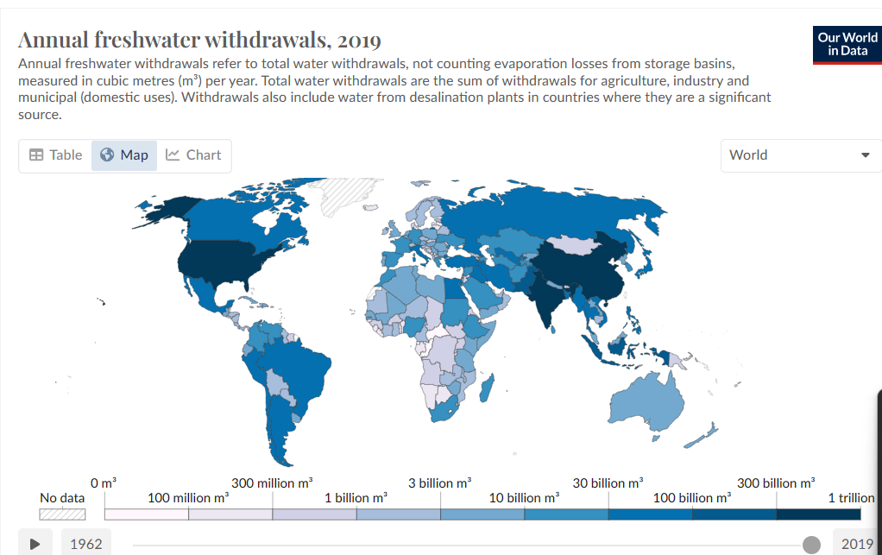
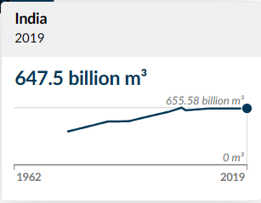
Current Challenges

Slide 5

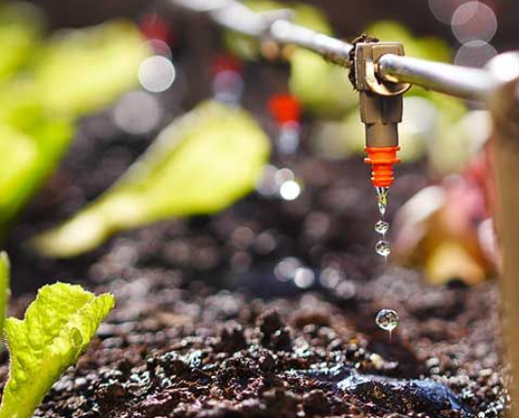
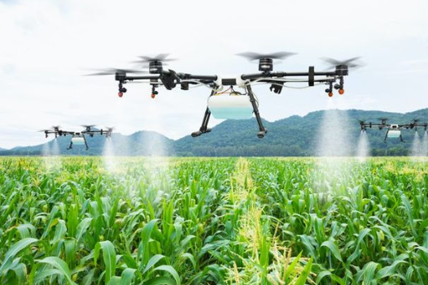
Technological Solutions
Drip irrigation
Precision farming
Sensor based system

Slide 6
Drip irrigation
Drip irrigation is a method of watering plants.
It delivers water directly to the root zone through tubing and emitters.
Water is released slowly and precisely, drop by drop.
This targeted approach minimizes water waste.
It reduces evaporation, runoff, and water loss due to surface runoff.
Drip irrigation systems are highly efficient.
They can be customized for different crops, soil types, and growing conditions.
Widely used in agriculture, landscaping, and gardening.
Promotes water conservation and sustainable water management practices
.Helps improve crop yields by providing water directly to the roots.

Slide 7

Precision farming
Precision farming, also known as precision agriculture (PA), is a farming management strategy that improves agricultural production sustainability by observing, measuring, and responding to temporal and spatial variability. It is used in both crop and livestock production.
Data Collection: Precision farming uses data collection tools, GPS, geographic information systems (GIS), remote sensing, and satellite imagery to optimize decision-making.
Variable Rate Technology (VRT): This technology allows farmers to vary the amount of seed planted or fertilizer spread based on field conditions such as soil types and moisture levels.

Slide 8
In Short
In summary, data collection and analytics empower farmers with valuable information and insights that enable them to optimize irrigation scheduling, enhance water usage efficiency, and ultimately improve crop yields and profitability.

Slide 9
An Upgrade Never Ends
Thanks for your time , attention and showing appreciation

